Slide 1
Gaming without Code
Kat Harris
@KatVHarris

Slide 2
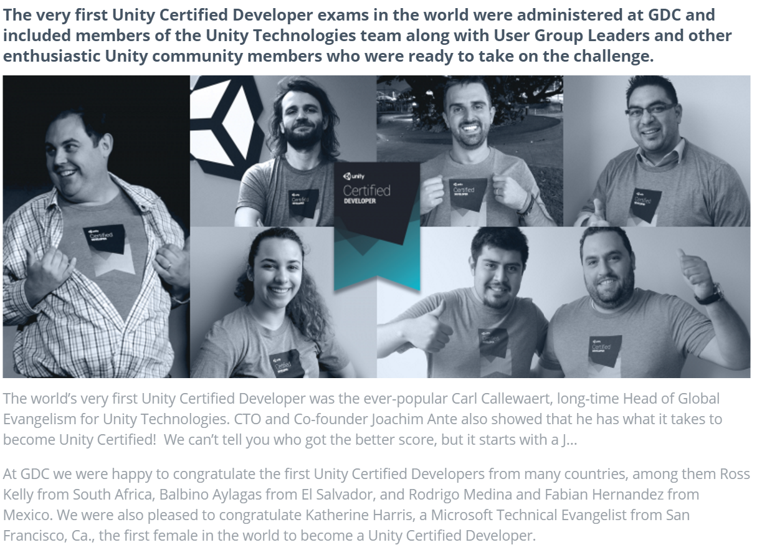
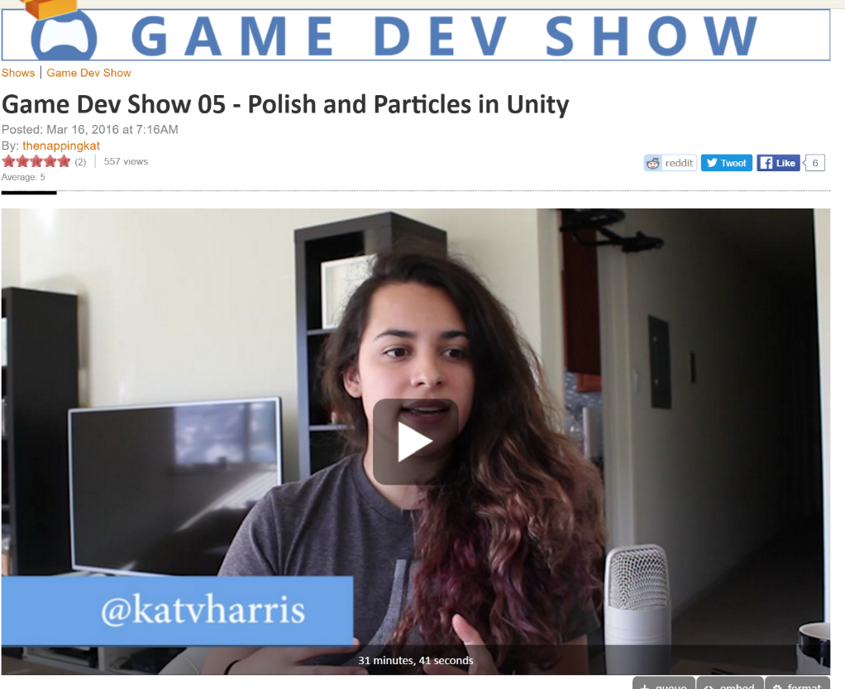

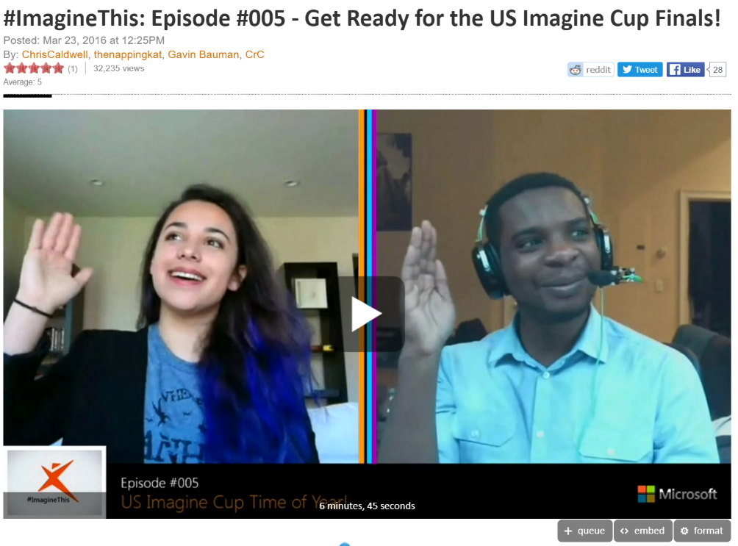
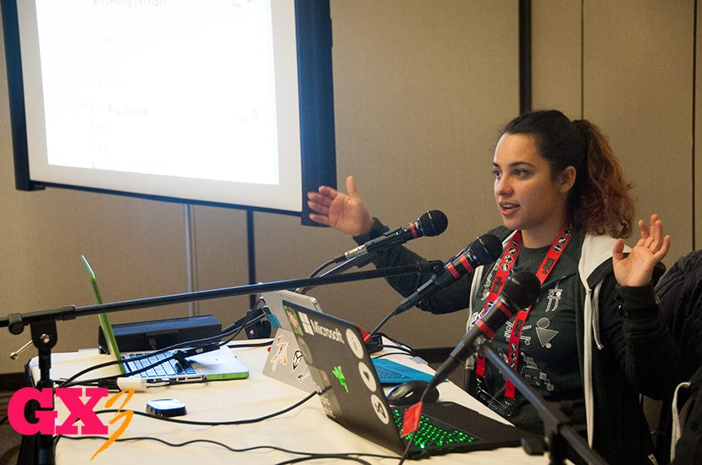
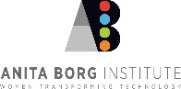
2015

Slide 3
AGENDA
Introduction / Goals
Game Dev and design
Tools
Build / Customize
Finishing Touches – Marketing, Release, Store Submission

Slide 4
What is a Game?

Slide 5
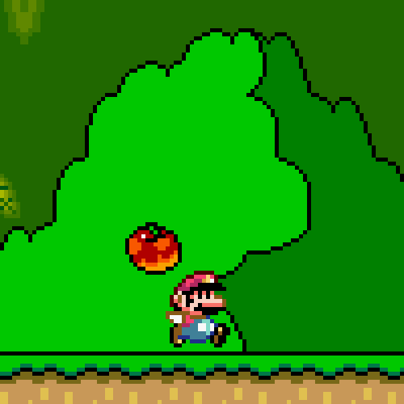
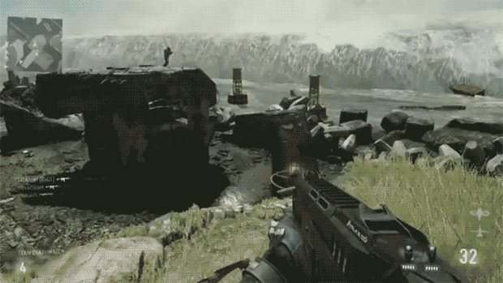
Platformer
Shooter

Slide 6
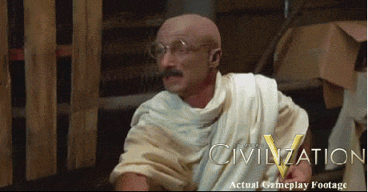
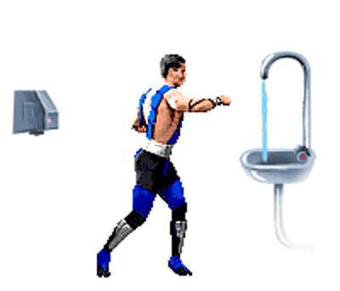
Strategy/
Puzzle
Fighting

Slide 7
Inspiration?
Video Game Name Generator
http://videogamena.me/
Fun with languages!
Dribbble
https://dribbble.com/
Which Platform(s)?
Depends on the audience

Slide 8
The Lean Startup
Minimum + Viable
Minimum Viable Product
A Feature or Product
Not Sacrificing Quality
List Feature-set
Rapid Releases
Minimum
Viable
Product nobody wants to use
Product built by companies better financed than you

Slide 9
Where Do I Start?!

Slide 10
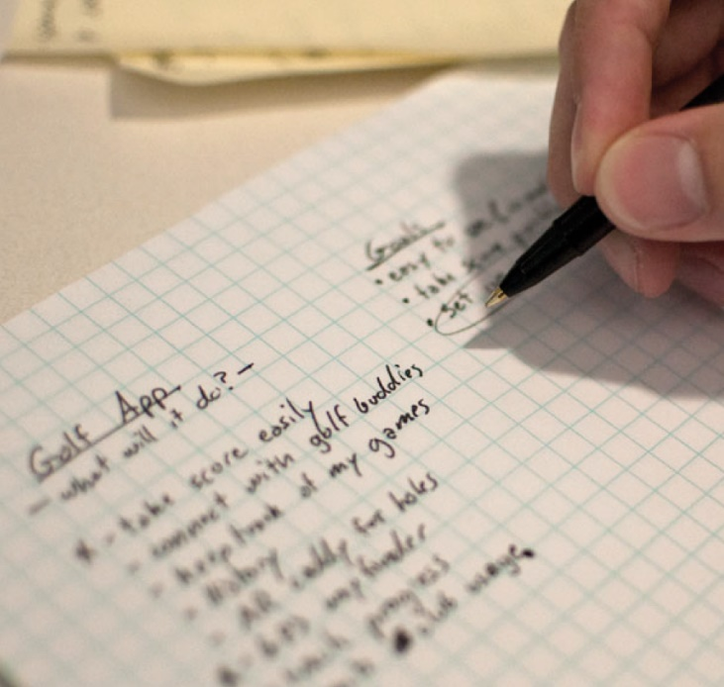
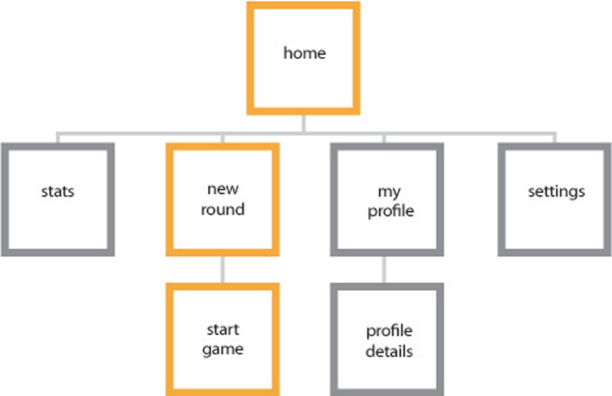
How To Start
Concept
Organize
Features
Functions
How
What
UX
Flow

Slide 11
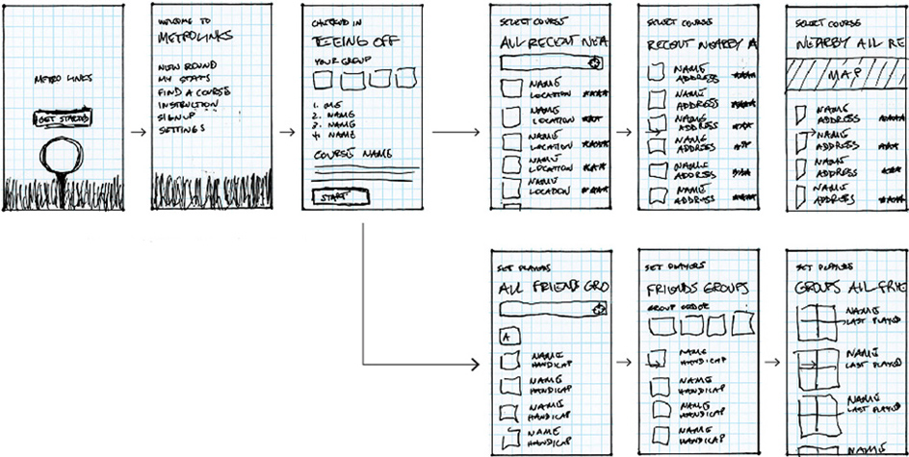
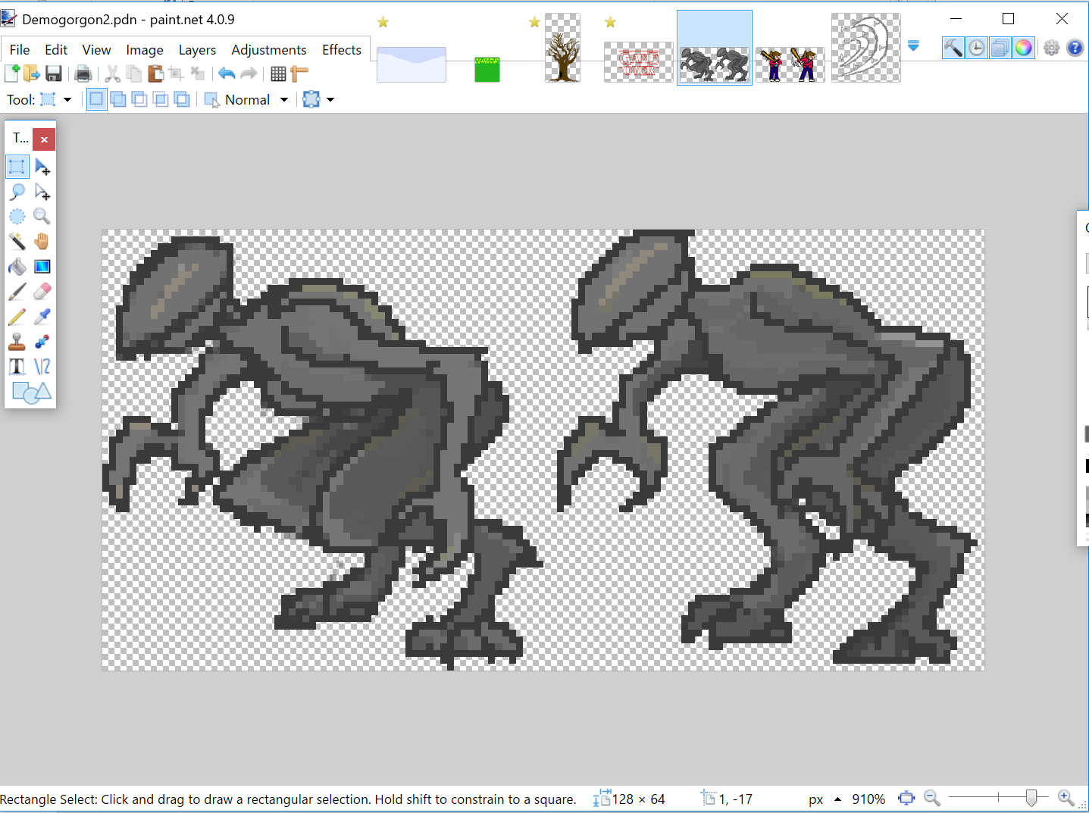
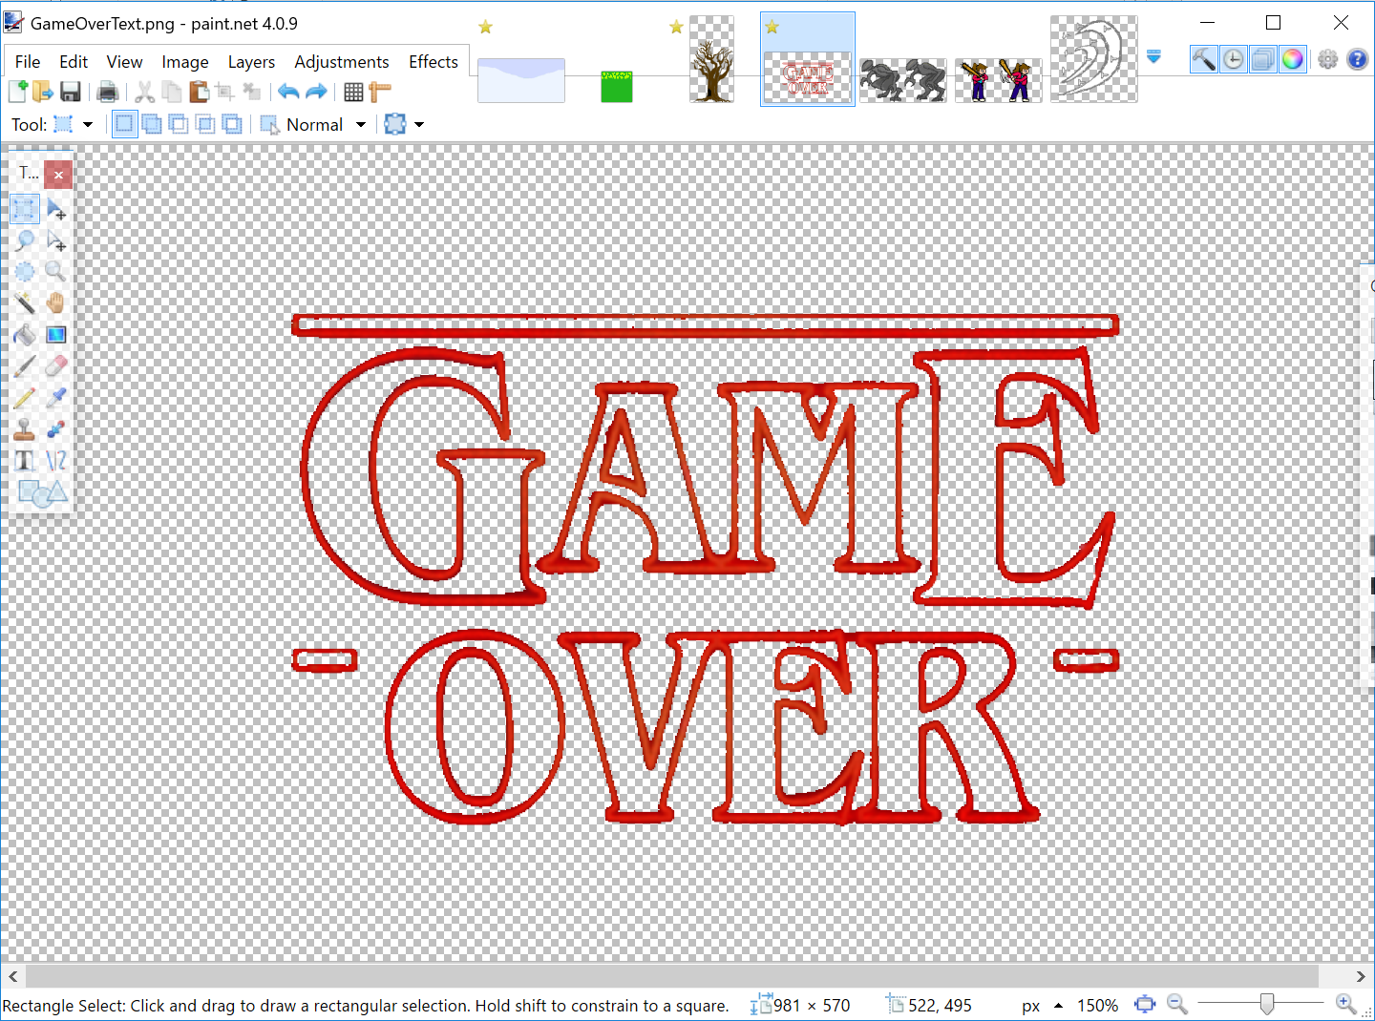
How To Start
Interaction Story
Visuals

Slide 12

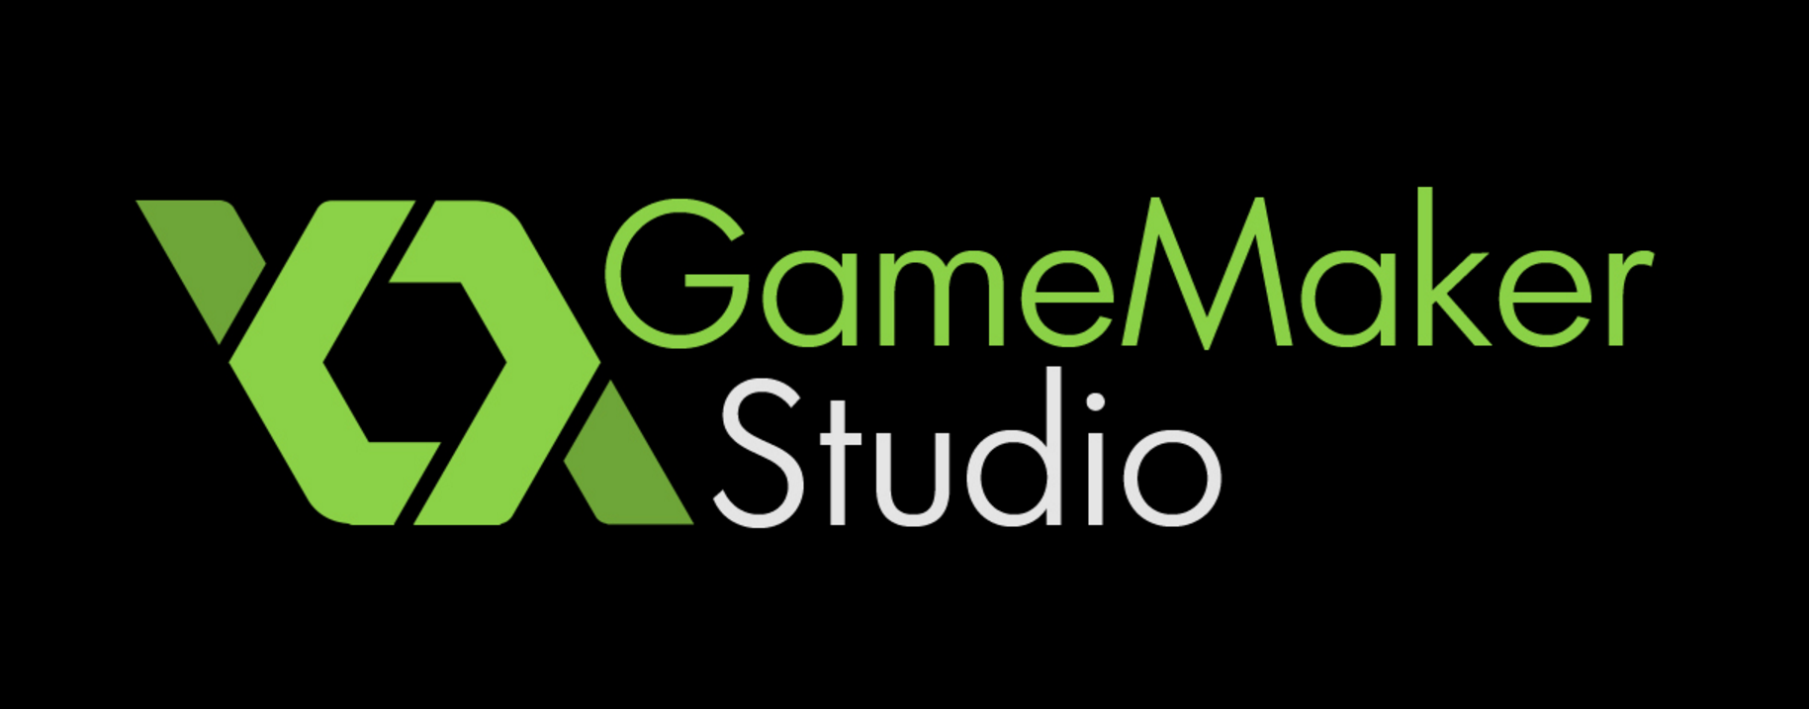

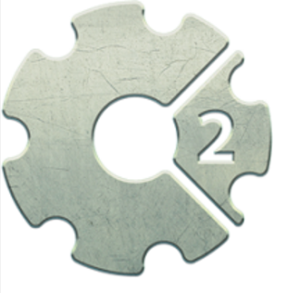

Tools

Slide 13
Twine2
Choose your own adventure game
Completely Online
Save Data!
Browser Access to your Story
Notes:
Since your work is saved only in your browser, if you clear its saved data, then you'll lose your work! Not good. Remember to use that Archive button often. You can also publish individual stories to files using the menu on each story in the story list. Both archive and story files can always be re-imported into Twine.
Secondly, anyone who can use this browser can see and make changes to your work. So if you've got a nosy kid brother, look into setting up a separate profile for yourself.
OK
Depression Quest – gamer gate

Slide 14
Demo
Building Branches
Adding Images
Creating Variables
Checking Conditionals
Embedding Passages in other Passages
Notes:
Building Branches
Adding Images
Creating Variables
Checking Conditionals
Embedding Passages in other Passages
[img[NAME OF PICTURE]] (the picture should be in the same folder you're building the HTML version of your story in).
<<silently>>
<<set $variable1 = “no”>>
<<set $variable2 = 0>>
<<endsilently>>
<<if $variable1 eq “yes”>> Some text here yay
<<else>>Other text instead <<endif>> gte, lte, gt, lt,
<<display ‘PassageName’>>

Slide 15
Hosting Twine game
Any web page
TwineHub
Philome.la
Textadventures.co.uk

Slide 16
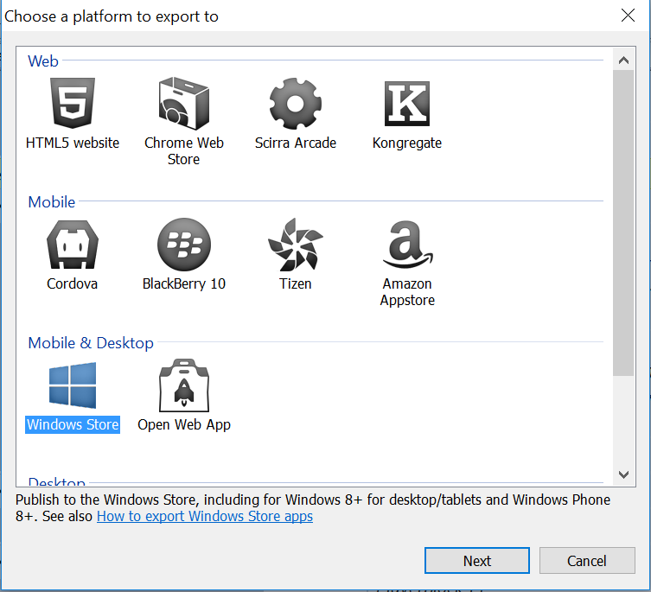
Construct 2
Game Development with Concepts
and natural language
Easy to use
Multiplatform

Slide 17
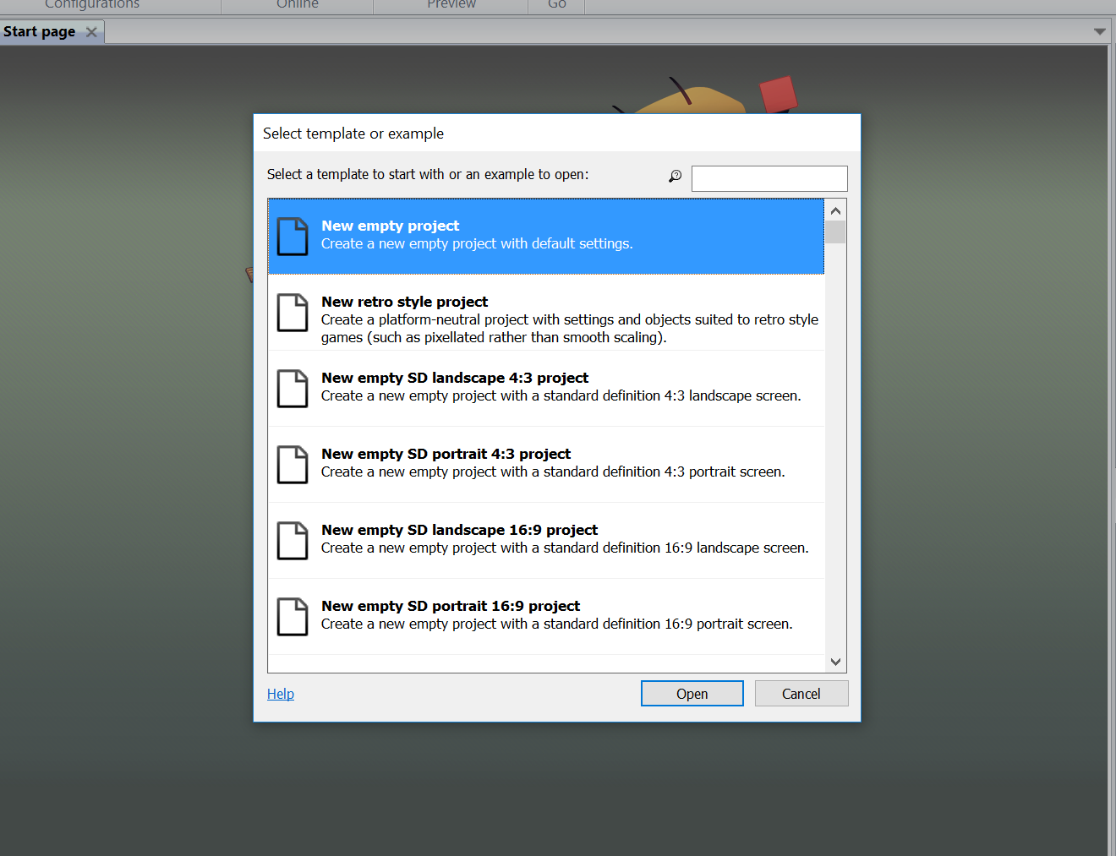
Create a Project

Slide 18
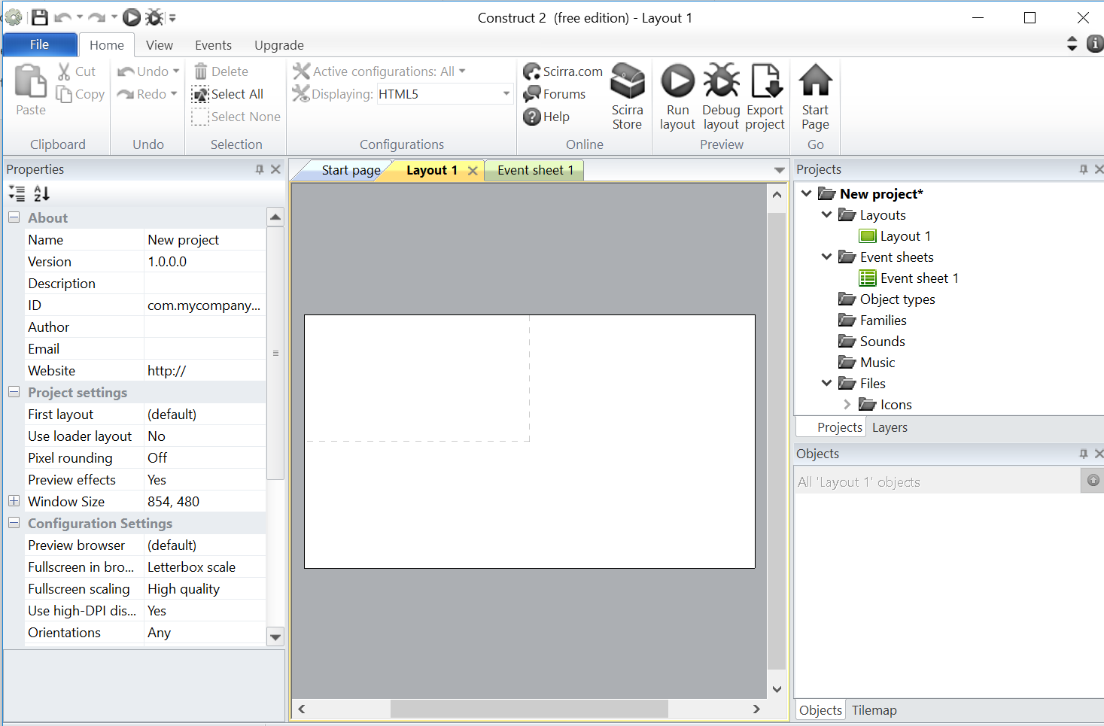
Layout
Notes:
layout = level

Slide 19
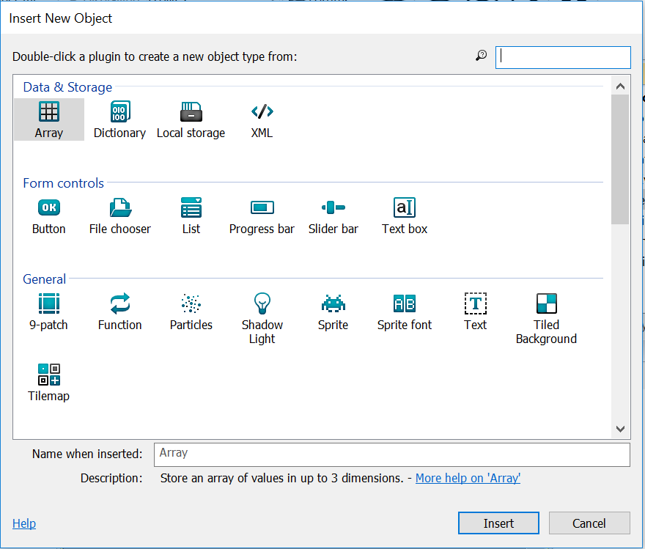
Objects
Add new layer
InsertNewObject
Object Layer
Scroll
EventSheet
New Event
System
Every tick -> Set X
TiledSystem.X-1

Slide 20
Behaviors
Player Movement
Sstem Behavrs

Slide 21
Input
Keyboard
Animation

Slide 22
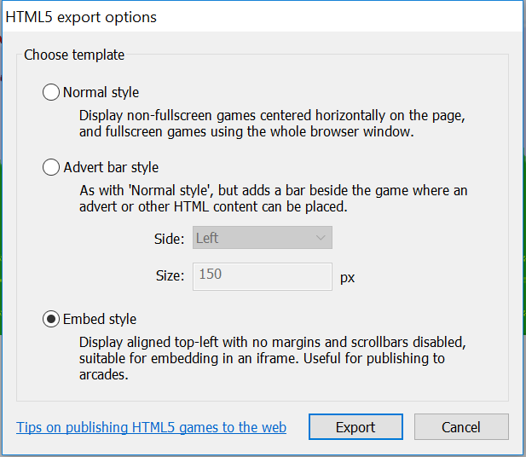
Publishing

Slide 23
What’s in a name?

Slide 24
Be Descriptive
The name helps sets the tone for the application experience.
Making your application name as descriptive as possible will make it easier for users to find it. Think about how a user might search for the application, and think about using those words. Embrace adjectives to make the title of the application more intriguing or compelling.
Notes:
Making your application name as descriptive as possible will make it easier for users to find it. A user might search for “counter”, “tracker” when searching for a calorie counting application. Carefully chosen adjectives can help sell the application – “easy”, “simply”, “smart” for example, might put a basic user at ease.
For a game, the same rules apply, but there definitely is a greater creative license to be had with the game title. Let us look at popular game titles: “Angry Birds”, “Plants vs Zombies”, “Temple Run”, “Fruit Ninja”. All of these titles convey one of two things: a) a struggle or challenge b) a context through an object. Both of these play right into what people desire when they are looking for any type of game. They are not looking for something to occupy them as much as they are looking for something to challenge them. Zombies and Ninjas are on the pulse of popular culture, so these names are likely to resonate with a large audience group. Get creative with your names for your game and explore a variety of adjectives to help convey the in-play experience to the user.

Slide 25
Keep it Short & Sweet
Shorter names will be more memorable and will be less likely to be truncated because of length when being displayed in the Windows Store.
Keep the name short and consider a catchy tagline that explains the intent of the application.
Notes:
In the Windows Store, an application name can having varying character lengths ranging from 15 to 23. Since the name and icon will be shown in a variety of areas, remember that a name that is too long will be truncated. More information on all the uses of your application name and icon in the Windows Store can be found here.

Slide 26
Naming Do’s & Don’ts
Do:
Keep the name simple
Make sure the name is available
Hint at what the application does
Provide a tagline for more abstract names
Don’t:
Use another company or product name as part of your name
Select a name hard to pronounce
Select a name hard to spell
Notes:
Using an existing company or product name as part of your name is not just bad form, it could be in violation of their EULA or terms and conditions. Most often, this becomes an issue if the application is a clone of an already existing product or it uses data from an API. Most APIs have terms and conditions that that a developer must respect (ahem, adhere to) when using them. If you are considering using an API, read the terms and conditions prior to starting: they are almost always listed on the APIs developer site.
If you want to use the API or product name to signify to the user that this is an application built on top of it, then you are best to keep it in the tagline or the description. For example, an application that takes advantage of the Instragram API to find pictures based on geolocation could be called something like “PhotoByYou” where the tagline could be “Instagram Photos taken by you”. Instagram’s terms and conditions, available here, clearly forbids the use of their name or variations of it. A complete list of best practices for working with API’s can be found here.
When working on a name, try to remember two simple tests.
Can it pronounced easily? If it doesn’t roll off the tongue, then it will be harder to share.
Can it be easily spelled? Although unusual or cute spellings can be overdone, I mean intriguing, they might result in missed organic traffic from internet searches.
Naming Do’s
Hint. Give the user a clue what your application might do. You don’t have to hand them Colonel Mustard in the library with the candlestick, but users appreciate a clever name once they have made the connection.
Keep it simple. Keep it short, concise, and if you feel it lacks detail, consider adding a tagline. For example: Vine – Make a scene.
Double check. Is that name available? The Windows Store requires all applications to have unique names. You will also want to check if an url is available in addition to all the social networking accounts any normal human being in the connected era could want.

Slide 27
Getting Started
Brainstorming ideas for how to get started:
Find inspiration in other languages. Latin, German, French, Italian
Create a collage by cutting out words from various sources. Mix and match.
Put together a mood board of images that relate to your application. Share with others to get a variety of words and terms to use.
Notes:
Consider other languages. What are similar words in Latin, German, Spanish? Perhaps those words are more intriguing that the English counterparts.
Get physical. Sometimes doing something with your hands can help with brainstorming. Embrace the art of collage and grab a few magazines or papers, and pay homage to William S Burroughs by utilizing the cut-up technique. Or, grab that game of Scrabble that has lovingly been staring at you and see what new words you can come up with by tossing the tiles around.
Do the social challenge. Post an image or a moodboard and ask your Twitter or Facebook community to start doing word associations or caption contests. Often popular culture references and terms can be discovered this way. ImageSpark is another great tool for putting together a visual moodboard designed to share.

Slide 28
Naming Resources
Consult the Thesaurus – Visual Thesaurus
Embrace Popular Culture – Visit Urban Dictionary
Use Domain Search Tools
Naming Worksheets – Use a naming worksheet
“How to Name Anything” – Follow the step by step directions in this great presentation http://www.slideshare.net/purewest/howto-namethings
Notes:
Consult the Thesaurus
Several online tools exist that will help you visually map words that are similar such as the Visual Thesaurus or WordStorm. Explore a variety of words much quicker with node diagrams.
Embrace Popular Culture
New words are being created all the time, sayings and quotes that suddenly become a part of our language. Check out what popular culture can offer from sites like the Urban Dictionary or Slang Vocabulary
Be Anything but Boring
Advice on how to avoid a boring name, along with pretty much everything else, can even be found on Youtube. Check out this video that includes some basic exercises and ideas to help you brainstorm a name that is anything but boring. http://www.youtube.com/watch?v=VikO6sNiBnE#at=49

Slide 29
Descriptions that Drive Downloads

Slide 30
Description Tips
Only the first few lines are seen in the description preview
Explain the intent of the application clearly and succinctly
Include awards, positive reviews, feature roadmap or change log as part of the greater description
Include keywords in your description that users may use to search. Utilize a key words tool to help
Notes:
How to Write a Good Description
Be default, only the first 3 or 4 lines of an application description is shown to the user. This is an opportunity to sell your application to the user. This description preview should clearly explain the intent of the application, as the rest of the description can be used to highlight features and confirm its value proposition. For a description, flowery language need not apply.
Consider starting with something that concisely describes the application
Include highlights or accomplishments. For example “Top 10 Free Game in the Windows Store”, or “10, 000 users love AppName”.
Tease. Suggest there is more to discover
Consider including complimentary reviews. If someone has given the application a positive review, why not include it in the description, as users will check the ratings and reviews.
Highlight the unique value proposition – why will this application make their life better, easier, more enjoyable?
Suggest what future iterations or versions might include to keep people interested and assure them the product will be actively supported and updated.
Include Keywords. Think about what your user might search for to find your application and see if you can naturally include those words into your description. Don’t force them into your description: it will show potentially causing distrust in the quality of your product.
Include the terms of use. For example if you are giving the user a preview by offering a trial mode, be kind and let them know how that works.

Slide 31
Description Tips
Max of 10,000 words for a description
Be descriptive, but don’t be unnecessarily verbose. Most users skim.
Format with bullet points when appropriate (feature lists, change log )
Highlight features that will interest your user, not that you find interesting.
Notes:
Regardless of the application ecosystem, descriptions will have a character limit. For the Windows Store, descriptions have a limit of 10,000 characters. People tend to be skimmers, they will just scan the description, so be careful that you are not being unnecessarily verbose. Keep in mind that you have a section dedicated to features as well, so these don’t necessarily have to be woven into your description as a bullet list. If you are going to talk about features, remember that it is not always about you. Think about your user’s needs and interests and highlight features that address those.

Slide 32
Icons as First Impressions

Slide 33
Well Designed Icons
Communicate the intent of the application
Create visual interest
Set the theme and tone for the game narrative
Are simple, symbolic and fit into the overarching game design narrative
Notes:
Icons can do a great job of instantly communicating the intent of your application, or what your application does. In the context of the app store, the application icon will initially be listed amongst several other application icons, all rivals for the user’s attention. It should be simple, symbolic and effective; overcomplicated icon design can reduce its effectiveness to convey meaning.
Well-designed icons should take into account the overall design theme of the application ecosystem. For example, an icon designed for the Windows Store might seem out of place in other application stores and vice versa. The modern UI of Windows 8 focuses on content and typography – something many have categorized as flat design due to its lack of gradients, shadows, and general ornamentation. Icons that do not fit in with the overall OS aesthetic can be disconcerting.
Color also plays a big factor. Anything red can make a user feel unsettled, as it’s a color reserved for failure or urgency in applications. Alerts, warnings, and errors: all these tend to have red in them along with the inevitable exclamation point screaming at you to pay attention. Purple is often considered a difficult color to work with.

Slide 34
Creating Impressive Icons
Get a quick start with Icon Fonts
Start at the largest resolution, then size down and tweak the details
Start in black and white before delving into color
Get someone to make them for you – find a designer friend or use a design crowdsourcing site
Notes:
Design Crowd Sourcing
If you have no desire to tackle this part on your own, and don't really have access to a designer, you can easily get an icon created for you by a professional through various design crowdsourcing sites. Their business models might differ, but typically you write a brief for the project and a price. When writing a brief be sure to include what you are looking for, avoid jargon, include references, abuse adjectives, and list your dislikes as well. Be specific: don’t ask for a car when you have a fully loaded Porsche 911 Turbo in slate grey in mind. You can read a good article on how to get the most from crowdsourced design here.
99 Designs http://99designs.com/
CrowdSpring http://www.crowdspring.com/
Freelancer http://www.freelancer.com/contest/
Tips for Icon Design
If you want to flex your own design skills, you can pick your favorite graphics program and go to town. Here are some tips for icon design:
Start large. It is easier to start with the bigger size and then resize down for the varying resolutions.
Be careful using text in your icons / logo – it may become very hard to read at smaller sizes.
Resize down and tweak. This will afford you the opportunity to polish the smaller sizes as scaling down proportionally may reduce the design fidelity on certain details.
Reduce the image size. There are many tools and approaches to do that
http://trimage.org/
http://imageoptim.com/tweetbot.html
http://www.smashingmagazine.com/2009/07/15/clever-png-optimization-techniques/
http://tinypng.org/
If you need a quick start and don’t want to start from scratch, considering using an icon font. These will provide a solid foundation for an icon, giving you the option to modify or tweak as you see fit. A list of icon fonts have been compiled that might do the job, or perhaps provide you with some ideas and inspiration.
Icon Design Resources
https://kippt.com/bitchwhocodes/icons
Creative Inspiration
https://kippt.com/bitchwhocodes/flatui

Slide 35
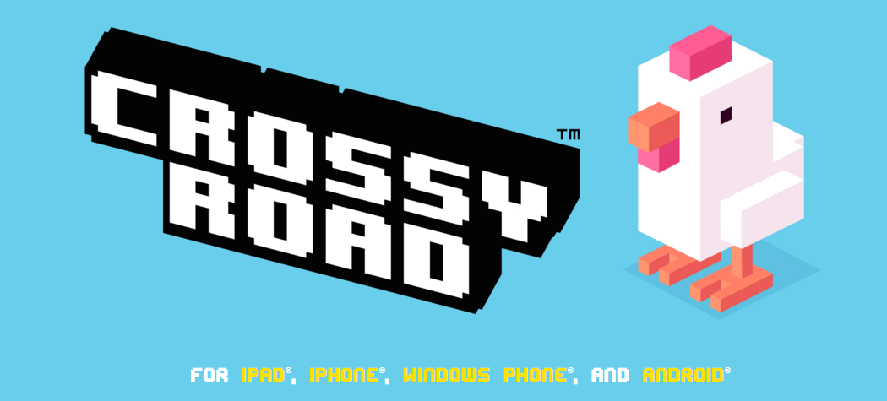
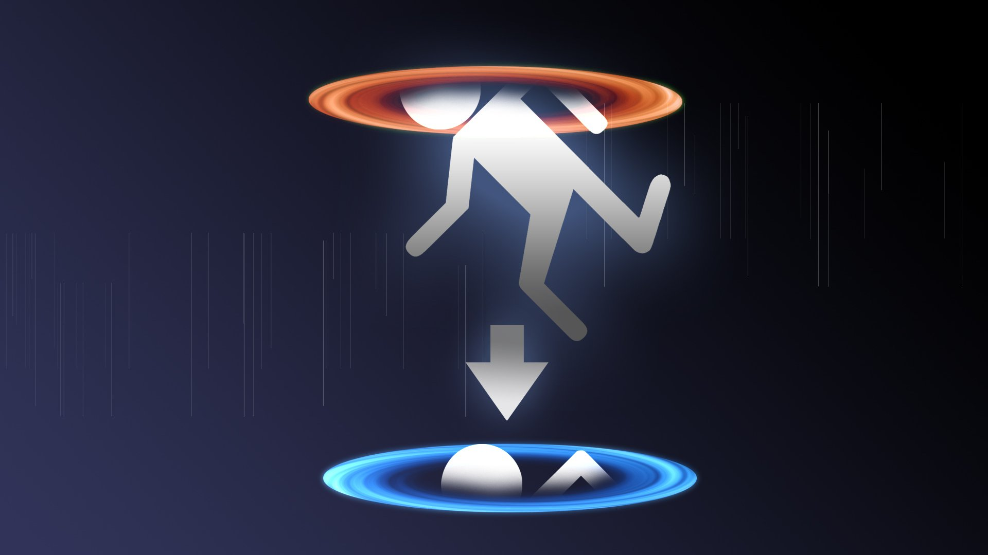
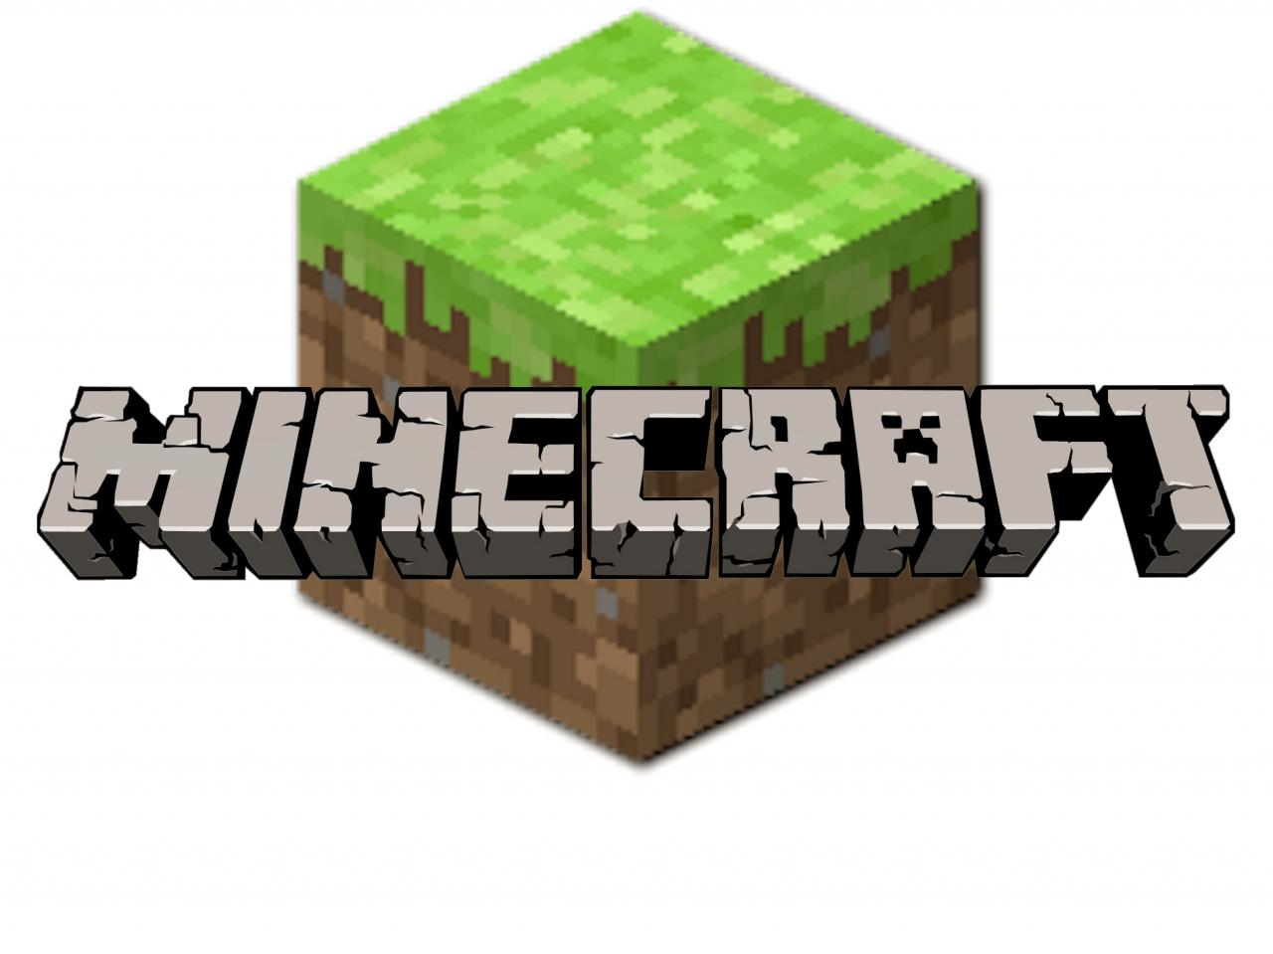
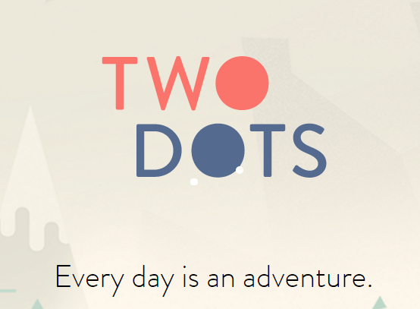
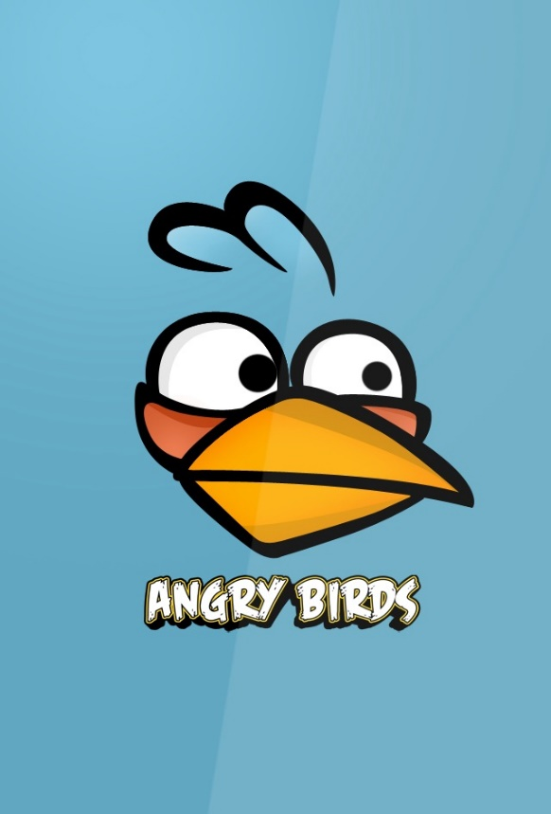
Notes:
Examples of great Iconography

Slide 36
Sell through Screenshots

Slide 37
Screenshots
Screenshots sets the user expectation for the application experience. If the first screenshot looks desolate and boring, the user will assume that is true of the entire application..
Notes:
Screenshots sets the user expectation for the application experience. If your first screenshot looks desolate and boring, the user will assume that is true of the entire application. It is important to pay attention to your first screen shot – many users might not stay long enough to browse your complete set of screenshots if the first one isn’t appealing enough.

Slide 38
Screenshots Do’s & Don’ts
Do:
Show off features
Illustrate depth of experience with variety
Optimize images
Don’t:
Submit multiple screenshots of the same thing
Submit low quality images
Notes:
Using an existing company or product name as part of your name is not just bad form, it could be in violation of their EULA or terms and conditions. Most often, this becomes an issue if the application is a clone of an already existing product or it uses data from an API. Most APIs have terms and conditions that that a developer must respect (ahem, adhere to) when using them. If you are considering using an API, read the terms and conditions prior to starting: they are almost always listed on the APIs developer site.
If you want to use the API or product name to signify to the user that this is an application built on top of it, then you are best to keep it in the tagline or the description. For example, an application that takes advantage of the Instragram API to find pictures based on geolocation could be called something like “PhotoByYou” where the tagline could be “Instagram Photos taken by you”. Instagram’s terms and conditions, available here, clearly forbids the use of their name or variations of it. A complete list of best practices for working with API’s can be found here.
When working on a name, try to remember two simple tests.
Can it pronounced easily? If it doesn’t roll off the tongue, then it will be harder to share.
Can it be easily spelled? Although unusual or cute spellings can be overdone, I mean intriguing, they might result in missed organic traffic from internet searches.
Naming Do’s
Hint. Give the user a clue what your application might do. You don’t have to hand them Colonel Mustard in the library with the candlestick, but users appreciate a clever name once they have made the connection.
Keep it simple. Keep it short, concise, and if you feel it lacks detail, consider adding a tagline. For example: Vine – Make a scene.
Double check. Is that name available? The Windows Store requires all applications to have unique names. You will also want to check if an url is available in addition to all the social networking accounts any normal human being in the connected era could want.

Slide 39
Splash Screens

Slide 40
Splash Screen
A splash screen is shown immediately when the application is launched. This is the first thing the user will see when they use your application - make sure to take advantage of this opportunity to build brand awareness.
Notes:
A splash screen is displayed immediately after a user launches your application, and remains until the application is ready for interaction. After your icon, this will be the next visual introduction the user has to your application, even if they only see it momentarily. It is best to keep this image simple, with your logo centered and leaving plenty of white space. A great example of this is the splash screen for Skype. It’s simple, has plenty of whitespace, uses the logo gives the user a sense of what to expect..

Slide 41
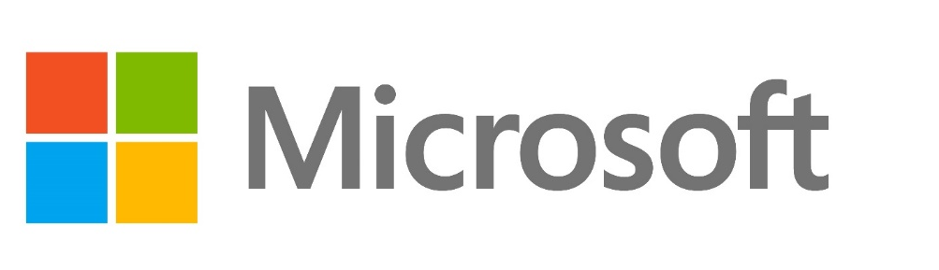

Katherine (Kat) Harris
Twitter: @KatVHarris
Blog: look on twitter http://katvharris.azurewebsites.net
Email: kaharri@Microsoft.com
GitHub:
https://github.com/KatVHarris/
Notes:
ME
GitHub
Unite
AUDIENCE
Now before we get to that I wanted to talk to you I wanted to tell you a little about myself and why I wanted to talk to you about this topic. As I mentioned before I’m an evangelist at Microsoft. Does anyone know what that is? It means that I get to play with cool technology and gamify almost anything I can get my hands on. As well as teaching others how to do the same. So everything I talk about will be released on my blog next week. And the base project for what I do is on github. I use that project as a simple Unity game.
I recently made a Kinect and Oculus integrated infinite runner. And after I completed it I wanted to release it into the store. But before I could I went to Unite Unity’s Dev conference in Boston. I learned about there new analytics and ads systems. And how the pay off of using these sytems was so large with virtual no overhead. So that’s what I’m going to show you today.

